Slide 1

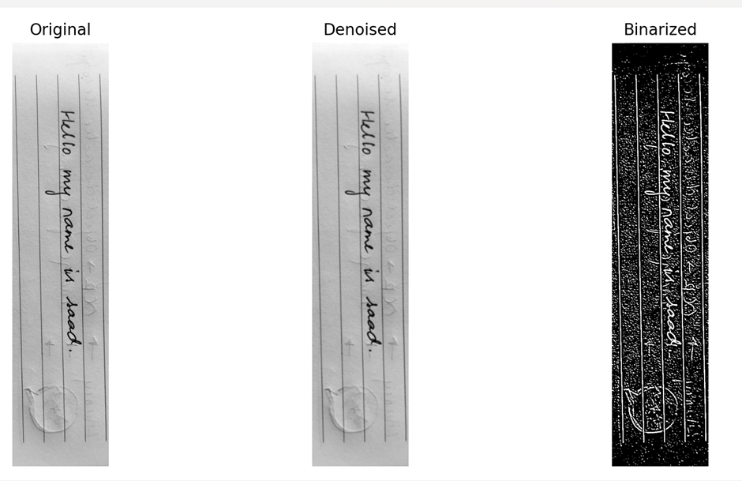
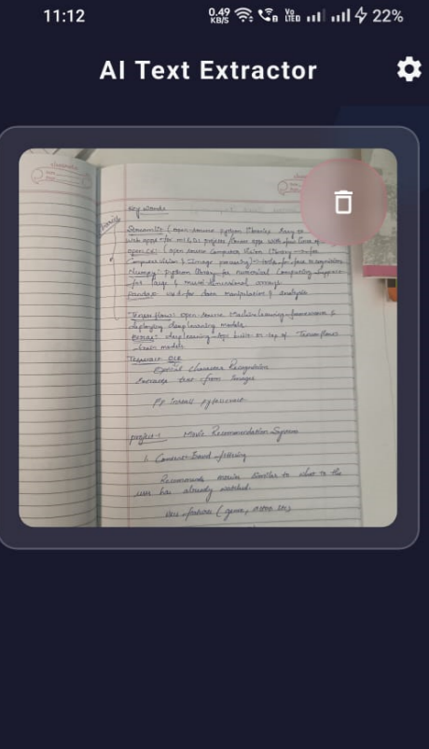
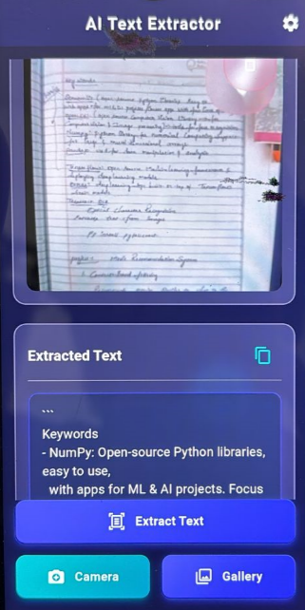
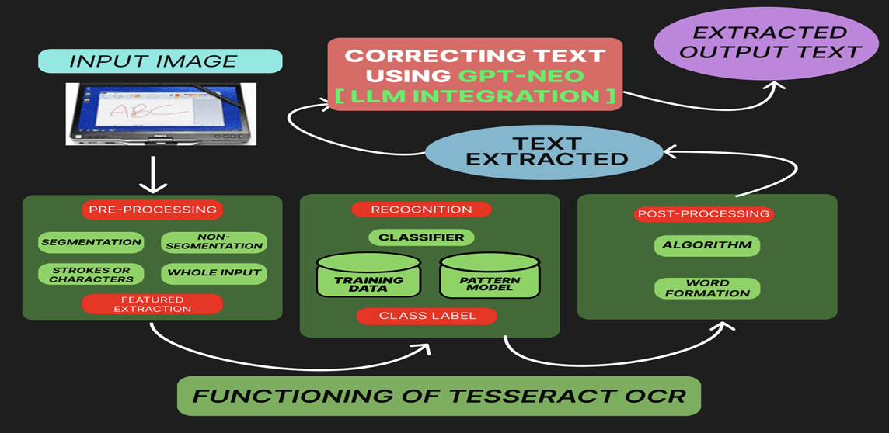
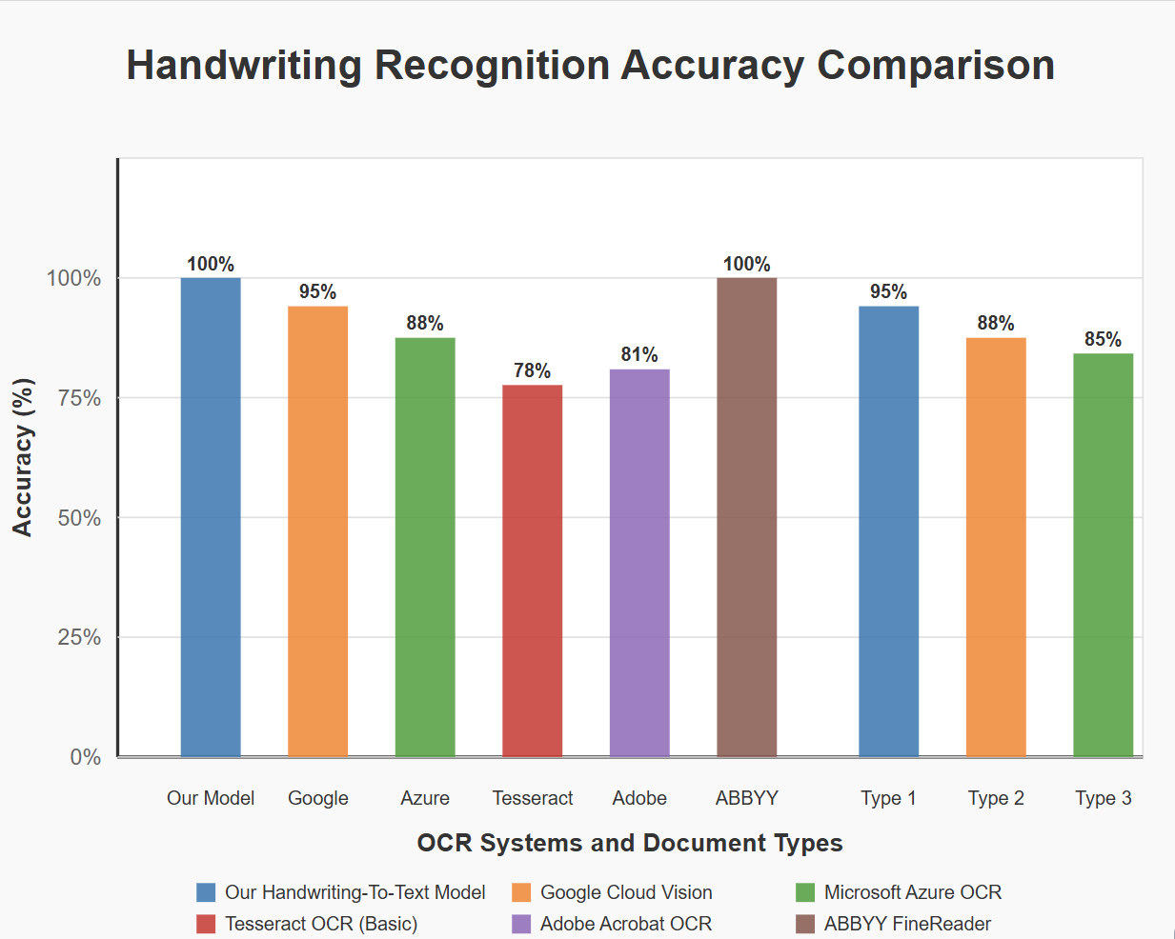
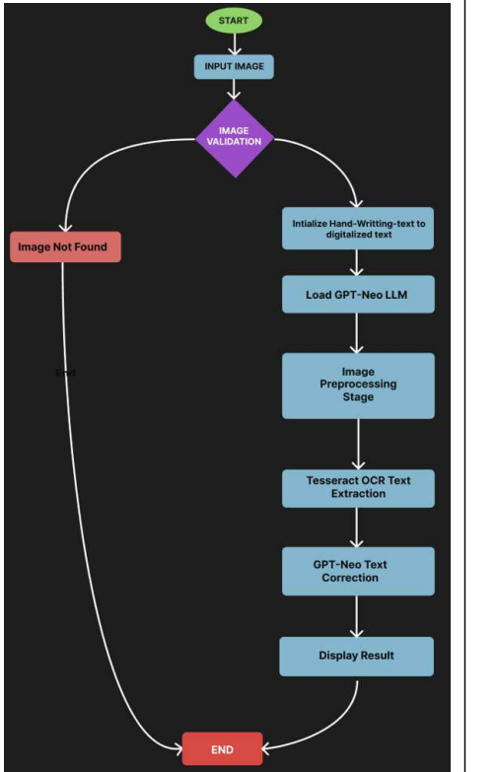
SCHOOL OF COMPUTER SCIENCE AND ENGINEERING
REVA CSE PROJECT EXPO - 2025
Conversion of Handwritten Text into Digitalized Text
Syed Saaduddin Anish Kumar Varun Teja Prabhat Rathore
saadsyed837@gmail.com anishkumar31804@gmail.com velidivarunteja@gmail.com prabhatrathore,pr@gmail.com
GUIDE Name:Prof. Kanaiya V Kanzaria
2104237@.reva.edu.in 2108977@reva.edu.in 2108753@reva.edu.in 2108684@reva.edu.in
Figure 2: GPT-Neo as the Large Language Model (LLM)
Conclusion
Abstract
Objectives
Results
Handwritten text recognition (HTR) is a crucial area of research that focuses on the conversion of handwritten text into digitized text. This process leverages various technologies and algorithms, including Optical Character Recognition (OCR), machine learning, and deep learning, to accurately interpret and digitize handwritten documents. The challenge lies in the variability of individual handwriting styles, the presence of noise, and the complexity of different languages and scripts. Recent advancements in neural networks, particularly convolutional neural networks (CNNs) and recurrent neural networks (RNNs), have improved the accuracy and efficiency of HTR systems. These systems are now used in a wide range of applications, including historical document digitization, form processing, and real-time text recognition in mobile applications. This abstract provides an overview of the techniques, challenges, and advancements in converting handwritten text into a digitized format, with an emphasis on the role of artificial intelligence and deep learning models in enhancing recognition accuracy.
.
.
.
The objective of this project is to develop an intelligent and efficient system that can accurately convert handwritten text into digitalized, machine-readable formats. By leveraging deep learning techniques, computer vision, and natural language processing, the system aims to recognize and transcribe handwritten characters and words from scanned documents or images. This project seeks to address the challenges associated with manual transcription, such as time consumption, human error, and limited scalability.
The proposed system for converting handwritten text into digitalized formats offers an effective solution to the long-standing challenge of digitizing handwritten documents. By employing advanced deep learning techniques and computer vision algorithms, the system can accurately recognize and transcribe handwritten content into editable, searchable digital text.
This automation significantly reduces the time, effort, and human error associated with manual transcription, while improving data accessibility and storage. The solution proves especially beneficial across domains such as education, healthcare, government, and historical preservation, where vast handwritten records still exist.
With its potential for scalability, language adaptability, and ease of integration, the system serves as a practical and impactful tool for modern document digitization and archival processes.
Proposed Solution
he proposed handwriting recognition system aims to deliver high-accuracy digitization of handwritten text using a blend of image preprocessing, optical character recognition (OCR), and large language model (LLM) post-processing. The core idea is to enhance conventional OCR with modern AI methods for better accuracy, especially for unstructured handwritten inputs .Key Components of the Proposed Solution. Image Input ModuleUsers upload or provide scanned handwritten images through an input interface.Image ValidationThis step checks for image integrity, resolution, and format. Invalid or missing images are flagged before processing.Image PreprocessingTechniques like denoising, binarization, thresholding, and contour detection are applied to enhance text clarity.
Figure 3: GPT-Neo as the Large Language Model (LLM)
Advantages:
Reduces the need for manual transcription by automating the conversion process, saving significant time and effort.
Utilizes advanced OCR and deep learning techniques to ensure precise recognition of varied handwriting styles.
Introduction
Future scope
The future scope of this project is vast and promising, given the growing demand for digitization and automation. One of the key enhancements could be the integration of multilingual handwriting recognition, enabling the system to support diverse regional and international scripts, including cursive and complex handwritten forms. Additionally, the system can be extended to work on mobile platforms, allowing users to capture and convert handwritten content in real-time using smartphone cameras. Incorporating Natural Language Processing (NLP) will further improve the accuracy of digitization through intelligent text correction and contextual understanding. Cloud integration for storage and management of digitized documents would facilitate easy access, sharing, and long-term archival.
With the rise of digitization, converting physical data—especially handwritten documents—into digital formats has become increasingly essential. Manual transcription is often slow and prone to errors, creating a strong demand for automated solutions. Handwritten Text Recognition (HTR) technologies, powered by AI and Optical Character Recognition (OCR), offer accurate and efficient conversion of handwritten content from images into editable text. These tools are crucial across various industries such as education, healthcare, legal, and archival research. This project aims to implement and enhance methods for digitizing handwritten text, addressing challenges like variability in handwriting styles, spacing, and formatting to improve accuracy and reduce human effort. Additionally, it seeks to support multilingual recognition, making the system more versatile and applicable across different languages and document types.
The advancement of technology has made it increasingly important to bridge the gap between traditional handwritten text and digital formats. Handwritten text, though widely used in daily life for notes, forms, and other documents, poses challenges in storage, retrieval, and sharing due to its nondigital nature.
Figure 4: Image of Handwritten text converted into digital format in mobile application
Fig.1. Flowchart of the process of text recognition and conversion.
[5] Zaman, M. & Ahmed,
References
Methodology
[1] Hao, W. (2024, May). Deep Learning Based Image Text Recognition Technique in Digital Auditing Research. In Proceedings of the 2024 International Conference on Computer and Multimedia Technology (pp. 100-104). [2] Gupta, N., & Goyal, N. (2021, January). Machine learning tensor flow-based platform for recognition of handwritten text. In 2021 International Conference on Computer Communication and Informatics (ICCCI) (pp. 1-6). IEEE. [3] Ghosh, M. M. A., & Maghari, A. Y. (2017, October). A comparative study on handwriting digit recognition using neural networks. In 2017 international conference on promising electronic technologies (ICPET) (pp. 77-81). IEEE. [4] Mishra, P., Pai, P., Patel, M., & Sonkusare, R. (2020, November). Extraction of information from handwriting using optical character recognition and neural networks. In 2020 4th International Conference on Electronics, Communication and Aerospace Technology (ICECA) (pp. 1328-1333). IEEE. [5] Chakraborty, B., Mukherjee, P. S., & Bhattacharya, U. (2016, December). Bangla online handwriting recognition using recurrent neural network architecture. In Proceedings of the tenth Indian conference on computer vision, graphics and image processing (pp. 1-8). [6] Dwivedi, U., Rajput, P., Sharma, M. K., & Noida, G. (2017). Cursive handwriting recognition system using feature extraction and artificial neural network. International Research Journal of Engineering and Technology, 4(03), 2202-2206. [7] Korovai, K., Zhelezniakov, D., Yakovchuk, O., Radyvonenko, O., Sakhnenko, N., & Deriuga, I. (2024). Handwriting Enhancement: Recognition-Based and Recognition-Independent Approaches for On-device Online Handwritten Text Alignment. IEEE Access.
Problem statement
With the ever-increasing speed of evolution in today's digital environment, companies and individuals are coming around to paperless operations and digital-first thinking more than ever. Still, there are certain segments such as healthcare, education, courts of law, and governments where handwritten reports remain the backbone. Several pivotal reports such as clinical documentation, student submissions, courtroom affirmations, and fieldwork are handwritten based on logistical constraints, personal inclination, or customary organizational standards. Converting these analog materials into usable digital forms is a continuing challenge for most organizations. Manual transcription techniques not only require enormous amounts of human effort but also are prone to numerous types of inaccuracy. Transcriptionists often struggle with reading poor handwriting, accidentally missing content, or adequately processing documents with multiple languages or complex writing styles.
Fig.5. Comparison table of different models
Fig.2. Flow-chart of handwritten text to digitalized text

